Slide 1
GBIF Implementation Plan 2017-2021 Highlights
Donald Hobern, GBIF Executive Secretary
Ochotona princeps (Richardson, 1828), American Pika, Rocky Mountain National Park, Colorado, USA, 21 September 2016

Slide 2
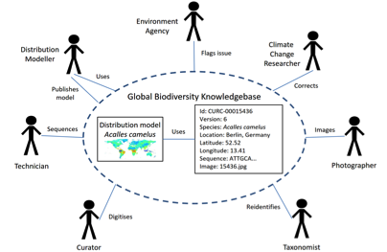
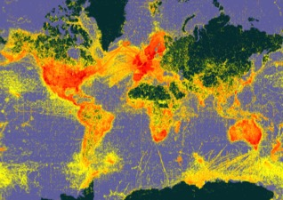
GBIF’s ROLE
Remove obstacles to collaboration in sharing and use of biodiversity data
Organise evidence of recorded occurrence of any species in time and space
Support development of a global virtual natural history collection

Slide 3
FIVE PRIORITIES FOR 2017-2021
Deliver Relevant Data
Improve Data Quality
Fill Data Gaps
Enhance Information Infrastructure
Empower Global Network
Notes:
GBIF has identified 5 focus priorities for the next few years

Slide 4
Empower Global Network
Activity 1b
Strengthen Skills

Slide 5
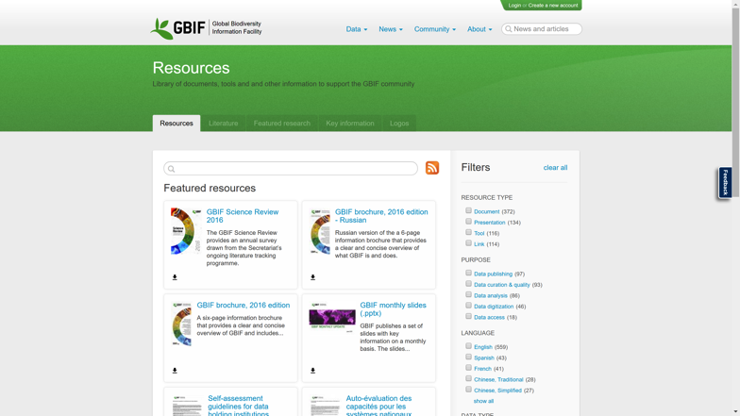
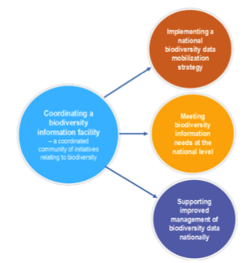
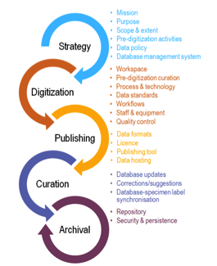
Training Curriculum for GBIF
Tasks
Roles
Topics
Tools
Building a BIF
Head of Delegation
BIF
Publish
Quality
Use
GBIF.org
Documents
Communications
Discussions
Helpdesk
Webinars
Node Manager
Capacity
Enhancement
Funding
CE programme
Supplementary funds
Data Publisher
Publishing Data
Mentor
Community
Mentoring
Translation
National work
programmes
Icon designed by Freepik from FlatIcon

Slide 6
Fill Data Gaps
Activity 3d
Rescue datasets

Slide 7
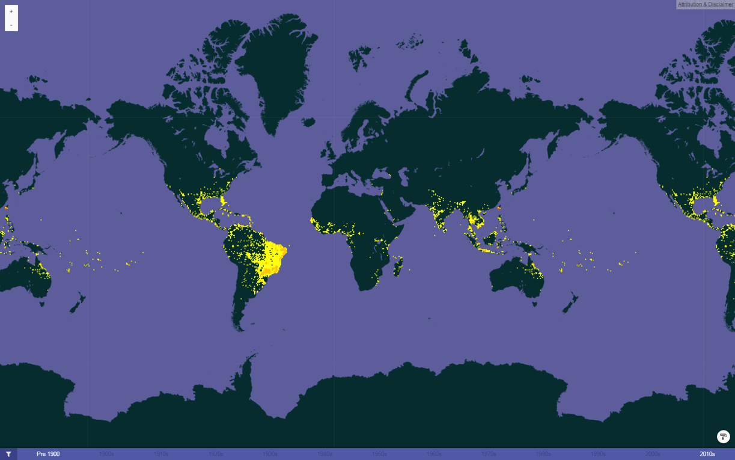
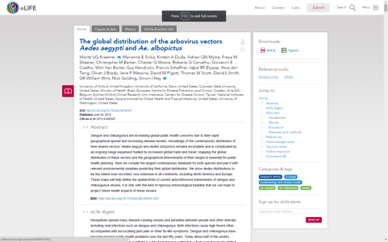
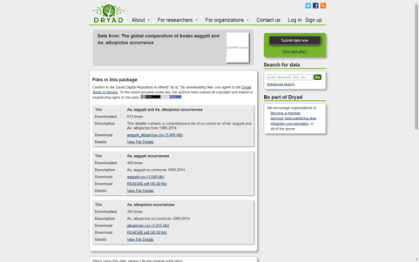
“Rescued” Mosquito Data
doi:10.7554/eLife.08347 / 10.5061/dryad.47v3c / doi:10.15468/7apj8n

Slide 8
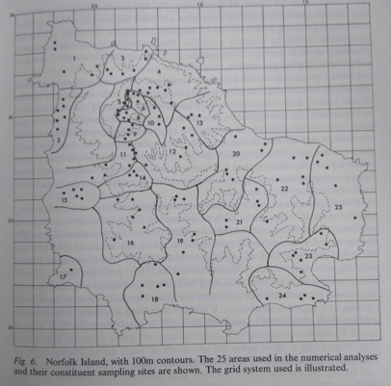
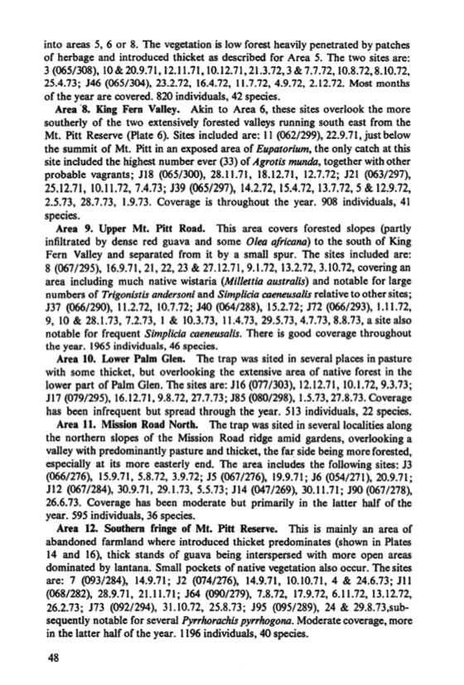
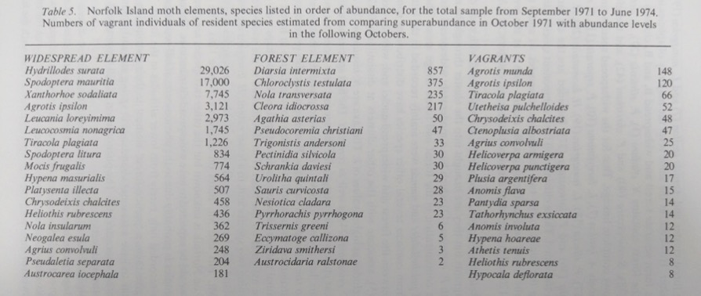
GBiF could connect so much more data
JD Holloway, The Lepidoptera of Norfolk Island – Their Biogeography and Ecology

Slide 9
How could this work?
Technical requirements
Web form – anyone can identify datasets of interest to GBIF
Tools and training materials for best practice data manipulation
IPT repository for “rescued” datasets
Process
Researcher (or citizen scientist) registers and receives training
Researcher adopts dataset
Partnership (where possible): researcher and original owner
Researcher cleans and publishes data in IPT repository
Joint credit for researcher and original owner (DOI)
Option for data paper, e.g. in Biodiversity Data Journal

Slide 10
Deliver Relevant Data
Activity 5c
Support Biodiversity
Assessment

Slide 11
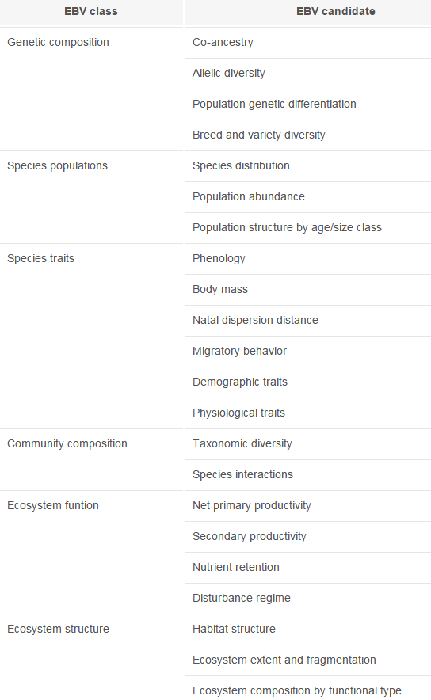
Essential Biodiversity Variables
http://www.gbif.org/

Slide 12
Measurements and Models AND EBVs
Species | X | A | B | C | D
Bird 1 | ~75 | 90 | 75 | 80 | 60
Bird 2 | ~25 | 60 | 50 | 1 | -
Bird 3 | ~4 | - | 11 | 8 | -
Bird 4 | ~30 | 12 | 2 | 54 | 82
...
Tree 1 | Possible | Present
Tree 2 | Likely | Present |  | Present
Tree 3 | Likely |  |  | Present
Tree 4 | Possible | Present
...
Fish 1 | Likely | Present | Present
Fish 2 | Unlikely |  | Present
...
Species | X
Bird 1 | ?
Bird 2 | ?
Bird 3 | ?
Bird 4 | ?
...
Tree 1 | ?
Tree 2 | ?
Tree 3 | ?
Tree 4 | ?
...
Fish 1 | ?
Fish 2 | ?
...
B
A
X
C
D

Slide 13
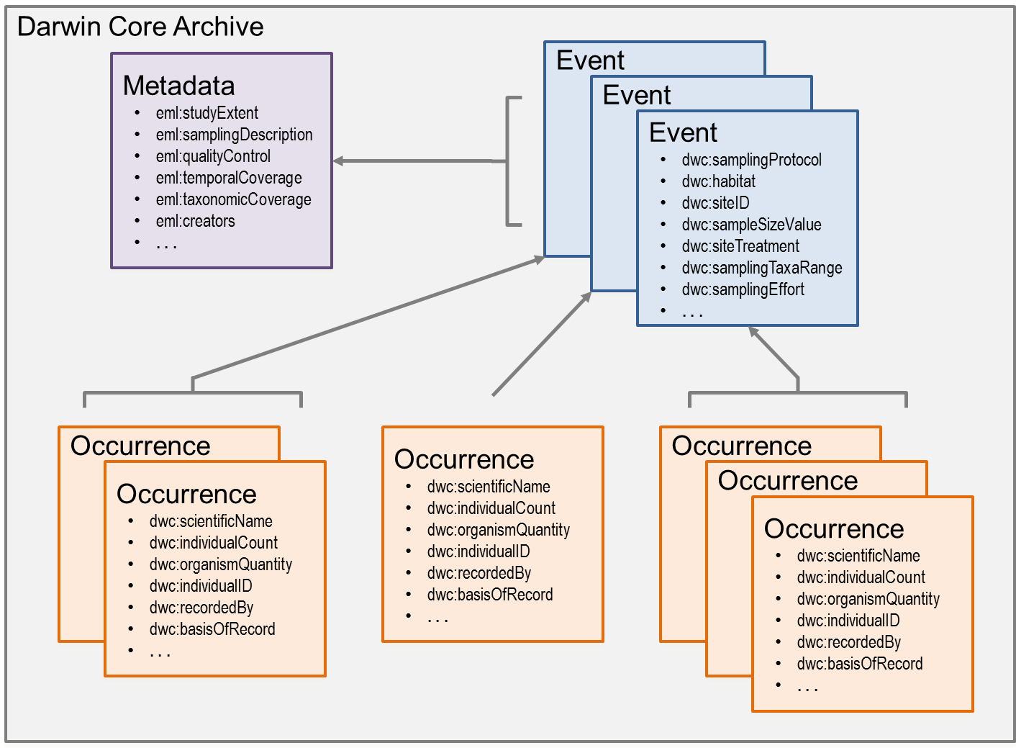
Sampling Event Data

Slide 14
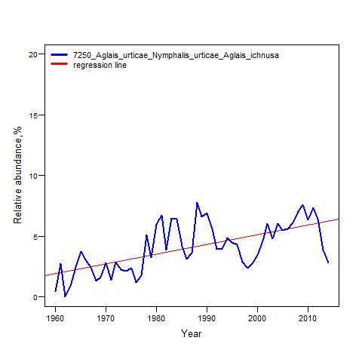
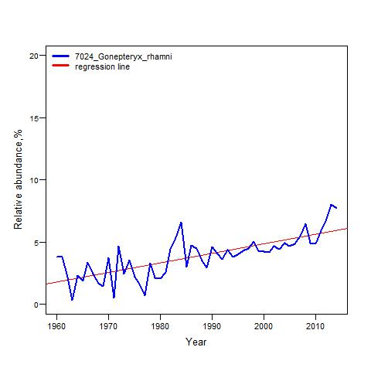
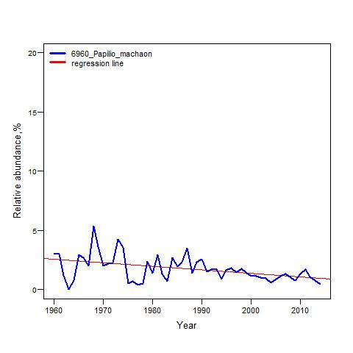
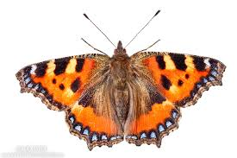
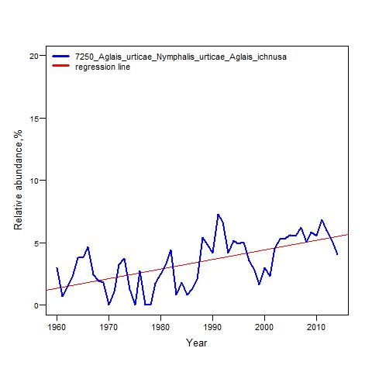
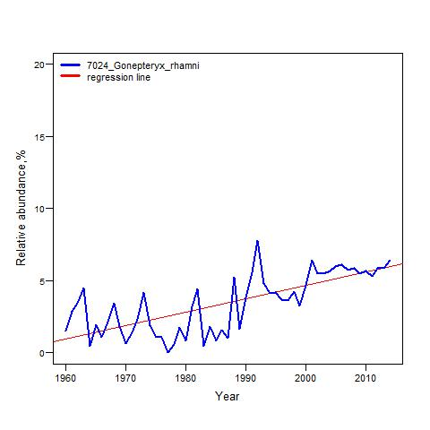
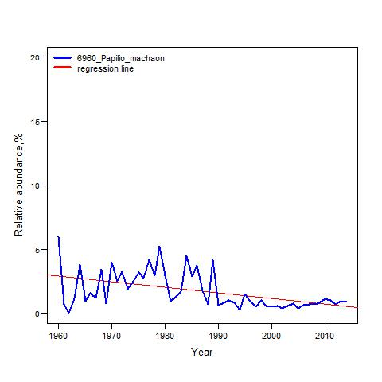
Signals from BULK Presence Records
Finland
Finland
Finland
14
Sweden
Sweden
Sweden
Slide from presentation by Hannu Saarenmaa at GLOBIS-B workshop, March 2016

Slide 15
Enhance Information Infrastructure
Activity 2b
Modernise Data
Standards

Slide 16
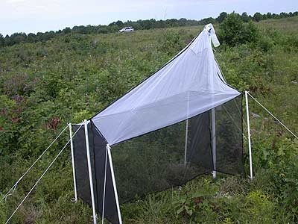
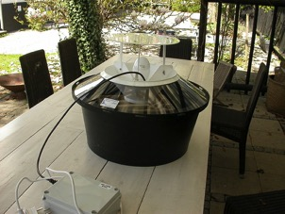
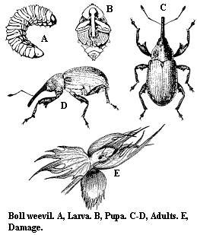
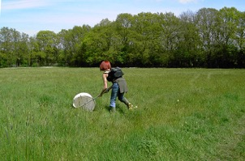
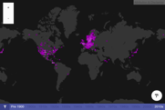
Biodiversity Knowledge Graph
Field
Research
Barcode
Sequences
Collection
Materials
Species
Information
BIN ABC0001
BIN ABC0002
.
.
.
CC-BY-SA 3.0 Ceuthophilus
BIN ABC0123
Aus bus
.
.
.
BIN DEF0987
.
.
.
Aus cus
BIN DEF9998
BIN DEF9999
CC-BY-SA 2.0 John Rostron

Slide 17
GBIF in the Knowledge graph
Sampling
Event
Sampling
Protocol
Sequence
Occurrence
Taxon
Interaction
Publication
Gene
Taxon Name
Collection
Specimen
Taxon
Concept
Trait

Slide 18
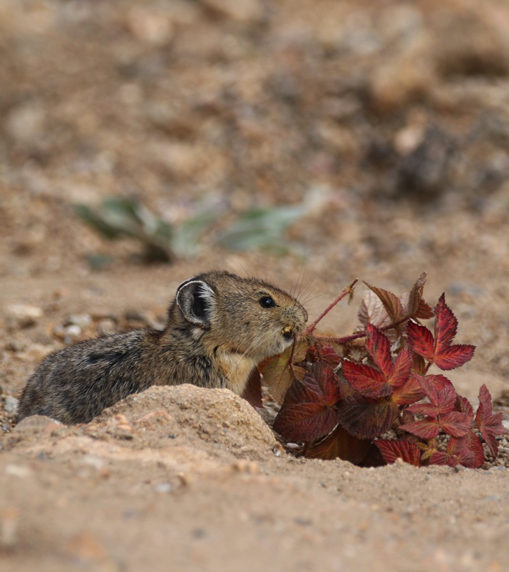
Thank you
Donald Hobern
GBIF Executive Secretary
dhobern@gbif.org
Notes:
GBIF exists to facilitate free and open access to biodiversity data in support of science and, through science, of science-based policy. The original OECD proposal for GBIF included an expansive vision for biodiversity content, including many areas which are now the domain of other international biodiversity informatics activities, including the Catalogue of Life, the Encyclopedia of Life, the Biodiversity Heritage Library and others.
GBIF itself serves as the global aggregation point for primary data on the occurrence of species, deriving mainly from natural history specimens and field observations. These data remain under the control of data publishing institutions located around the world. GBIF’s central services enable the data to be brought together and organised consistently to support user searches and downloads and to deliver basic GIS capability. Increasing numbers of peer-reviewed articles document research based on GBIF-mediated data.
GBIF has demonstrated the capability and effectiveness of its global network and of these data integration tools. Focus is now turning to improved understanding of the coverage and gaps in available data and to prioritising delivery of key data sets of high value to research. These priorities will include incorporating more detail on the sampling events from which many data records derive and on the representation of species abundance. GBIF will also work more closely with other biodiversity informatics activities to improve the interoperability between species occurrence data and other classes of biodiversity data.

