Slide 1
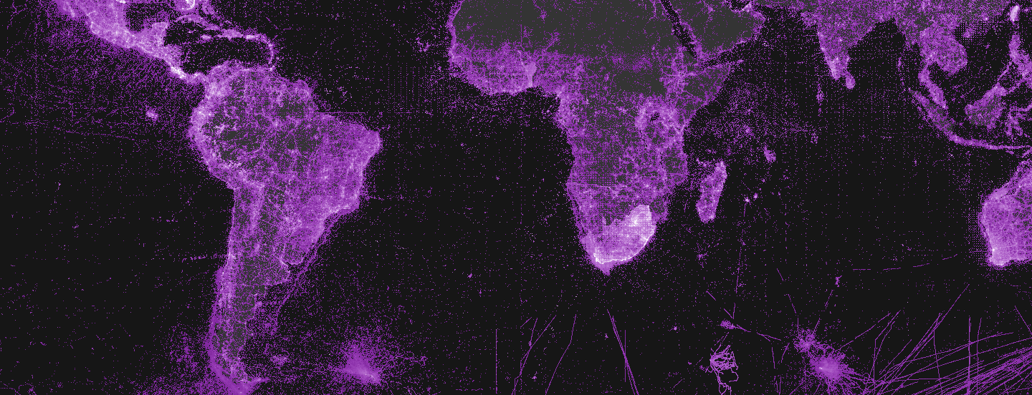
Colombia: Capacity enhancement in Latin America
Dairo Escobar
26 OCT 2016

Slide 2
CESP: COLOMBIA (2013 – 2016)
Mentoring activities
Regional training support
Documentation
Canada
Spain
Mexico
Costa Rica
Colombia
Peru
Brazil
Uruguay
Chile
Uruguay
Argentina
10
Countries
8
Projects
+200
People

Slide 3
MENTORING ACTIVITIES
Mentoring SiBBr (2013)
Lead: Brazil / Participation: Canada, Colombia.
Implementation of the data publication infrastructure (IPT-based)
A prototype data portal reusing the GBIF data portal code.
A two-year work plan to develop new biodiversity data applications, and strategies to integrate monitoring and environmental data into the GBIF framework.
www.sibbr.gov.br; www.sibcolombia.net; www.canadensys.net

Slide 4
MENTORING ACTIVITIES
Mentoring Plinian Core (2014)
Lead: Mexico / Participation: Spain, Costa Rica, Brazil, Colombia.
Plinian Core Mentoring: strengthening best practices for mobilizing species information.
A new version of the Plinian Core Abstract Model.
Vocabularies for key terms.
Pilot datasets published to test the new elements of the standard.
https://github.com/PlinianCore

Slide 5
MENTORING ACTIVITIES
Mentoring Uruguay (2015)
Lead: Uruguay / Participation: Brazil, Colombia, Canada, Cuba, Chile, Argentina.
Regional capacity enhancement by setting up Uruguay’s data portal.
Requirements and strategies document for the National Data Portal.
Production grade Uruguay National Data Portal.
Regional and local technicians trained in data publishing and data quality assessment tools.
First Uruguayan biodiversity data set published through the National Data Portal.
https://github.com/PlinianCore

Slide 6
REGIONAL TRAINING SUPPORT
Workshop on digital documentation (2014)
Lead: CYTED / Participation: Argentina, Brazil, Chile, Costa Rica, Colombia, Cuba, Mexico, Nicaragua, Spain, USA, Uruguay, Venezuela.
Linking biodiversity data, publications and images
Increase the capacity in the region to digitalize and publish biodiversity scientific literature, images and other multimedia objects.
Enhance the fitness for use of available data by linking occurrence, literature and multimedia.
http://www.recibio.net/taller-i3b-documentacion-digital/?postTabs=0

Slide 7
REGIONAL TRAINING SUPPORT
Workshop on data quality (2014)
Lead: Colombia / Participation: Mexico, Spain, Uruguay, Argentina, Brazil.
Improving primary biodiversity data shared and published through GBIF network
A best practice guide for data quality on biodiversity data after the training.
Tutorials with the key tools and protocols.
Data Quality assessment.
Consolidate a data quality community between nodes.
143
http://www.recibio.net/taller-i3b-documentacion-digital/?postTabs=0

Slide 8
REGIONAL TRAINING SUPPORT
Workshop on sample-data (2016)
Lead: Peru / Participation: Argentina, Colombia, Costa Rica, Chile, Uruguay.
Building capacity for documenting, cleaning and publishing sample-based data in Latin America.
To empower the Peruvian network in order to build capacity for publishing biodiversity information (occurrence records).
To enhance in general the capacity of the region for sample-based data mobilization.
Regional
Nodes
Meeting (April 2016)
http://www.recibio.net/taller-i3b-documentacion-digital/?postTabs=0

Slide 9
Documentation
Ibero­-American community (2016)
Lead: Colombia / Participation: Spain.
Facilitating the engagement of Ibero­-American community
To produce new learning and promotional resources that serve to bridge one of the linguistic gaps in the GBIF network.
A video tutorial explaining the data publishing process in simple language that increases the context and relevance for Spanish-speaking communities.
Toolkit that includes movie scripts, graphics, interview formats and multimedia reference materials
http://www.recibio.net/taller-i3b-documentacion-digital/?postTabs=0

Slide 10
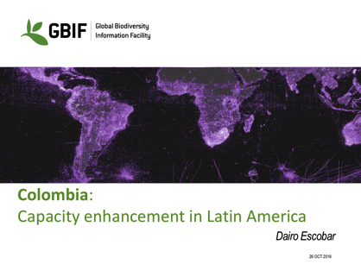
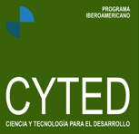
Thank you!
@daiesco

