Slide 1
Obtaining CC licenses from data publishers in Japan
Tsuyoshi Hosoya
JBIF(Japan Node)
16 Feb 2015

Slide 2
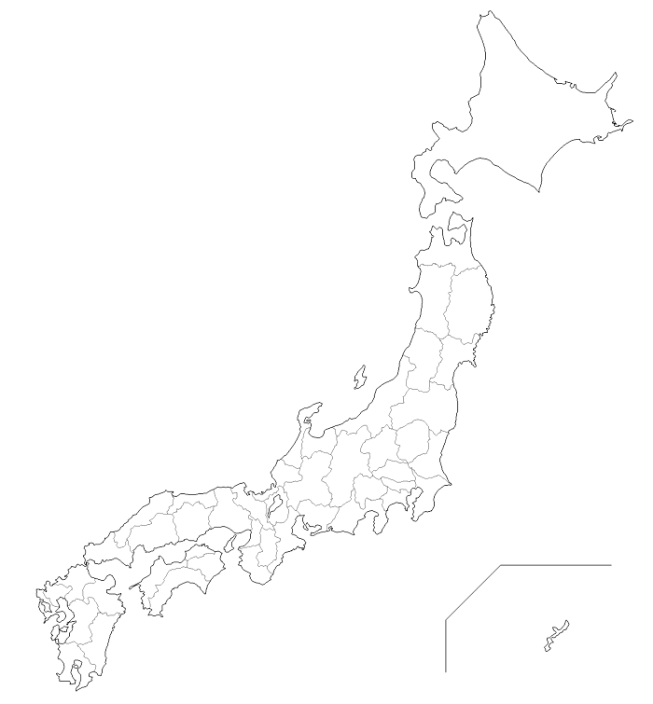
Background Information
>280 datasets from >80 organization (museums, university, and national institutions), provided to GBIF through two IPT servers.
Mostly specimen information of plants & animals.
1
2
●
●
1
●
●
●
4
3
●
30
5
●
●
33
●
8
9
34
●
10
●
●
●
●
7
●
13
●
43
●
14
●
35
●
16
11
●
●
19
18
17
31
20
●
12
●
●
36
●
●
21
15
●
51
●
●
●
40
●
●
●
46
●
●
●
27
45
●
●
41
37
32
●
●
●
●
24
22
●
●
●
52
●
●
26
29
●
53
●
47
●
●
38
25
●
28
44
42
39
●
●
60
57
●
●
48
23
●
●
54
49
61
●
●
●
●
●
●
55
●
63
62
56
58
50
●
64
●
●
59
65
●
遺伝研経由
国立科学博物館経由
国立環境研究所経由
66
●
●
●
●

Slide 3
What was the stating position regarding your publishers?
0
(Almost) Nobody knew “CC licensing”.
Few people were sensitive about “license” matter of the data.
Very few written materials in Japanese to learn CC licensing.

Slide 4
What was your approach to consulting Japanese publishers on acceptance of standard CC licenses?
1) Study (CC) licensing by ourselves.
2) Produce materials for learning/promotion.
a. 3 pages of concise text to explain the background and CC-licenses.
b. Translation of the materials provided from GBIF.
c. Slides for explanations.
3) Distribute the materials to the data publishers.
4) Provide seminars, learning opportunities.
5) Persuade individually.

Slide 5
What were some of the doubts expressed by publishers, and how did you attempt to overcome them?
In most cases, responses were positive and straightforward (CC-BY, even CC0).
Vague senses of unease to declare “free”
(probably over reaction to commercial use) (CC-BY-NC).
Individual persuasion worked.

Slide 6
What was the outcome in terms of the number/proportion that agreed to GBIF-compliant licences?
CC0 3
CC BY 217
CC BY-NC 44
Suspended 11
Withdrawn 7
Continuous persuasion for “suspended”.
Lessons:
1) Explanation for the concept of “licensing”
2) Intention for the licensing
should be provided at the beginning.

