Slide 1
GBIF.org milestones for 2016
Tim Hirsch, Deputy Director, GBIF Secretariat
GB23 Public symposium, brasÍlia, 26 october 2016

Slide 2
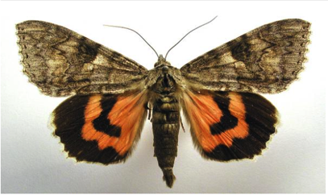
New datasets
49 sampling-event datasets including:
Insects from light trap (1992–2009), rooftop Zoological Museum, Copenhagen
Publisher: Natural History Museum of Denmark
Data host: DanBIF IPT
Light trap worked 4,500 night over 18 years collecting Lepidoptera and Coleoptera
>37,000 records, 7 moth species new to Denmark
Analysis published in Journal of Animal Ecology, data deposited in Dryad
Republished through GBIF, among first uses of sampling-event core
doi:10.15468/xabmiz. Photo: Catocala nupta by M.Virtala. CC0.

Slide 3
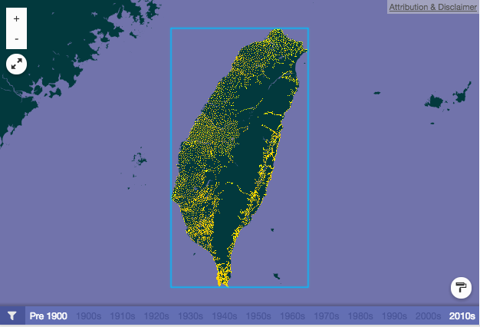

New datasets
49 sampling-event datasets including:
Alien plant presence dataset from the point-radius plot surveys in 2010-2015 in Taiwan
Publisher: Taiwan Forestry Research Institute
Data host: TaiBIF IPT
> 63k occurrence records of alien vascular plants
Intensive survey along road system of Taiwan, from 4,879 sampling plots, about 2km apart
May be used to estimate expansion of alien plants and evaluate invasiveness
doi:10.15468/dnne4z

Slide 4
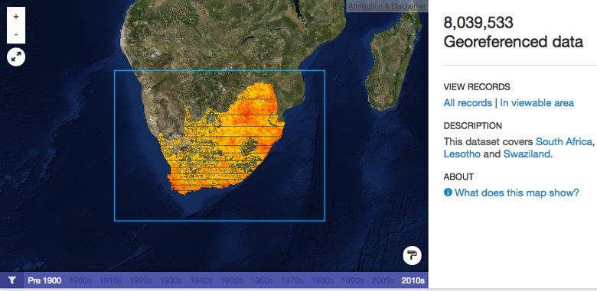
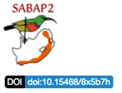
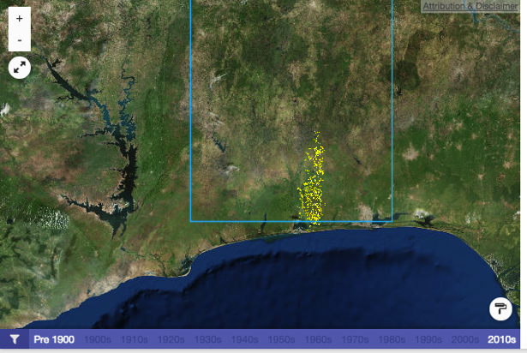
New datasets
Southern African Bird Atlas Project 2: Full protocol records
Publisher: Animal Demography Unit, Dept of Zoology, University of Cape Town
Répertoire des Forêts sacrées dans les Départements de l’Ouémé et du Plateau.
Publisher: GBIF Benin
Data mobilized in the framework of BID National project BID-AF2015-0065-NAC and funded by EU
doi:10.15468/8x5b7h, doi:10.15468/iozuua

Slide 5
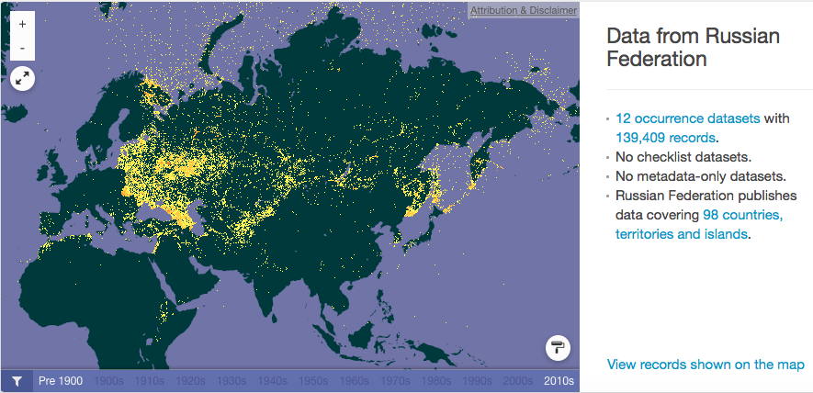
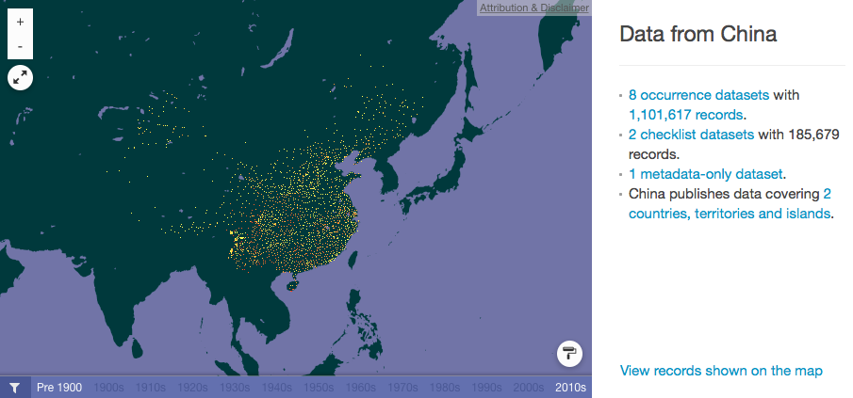
new publishing countries

Slide 6
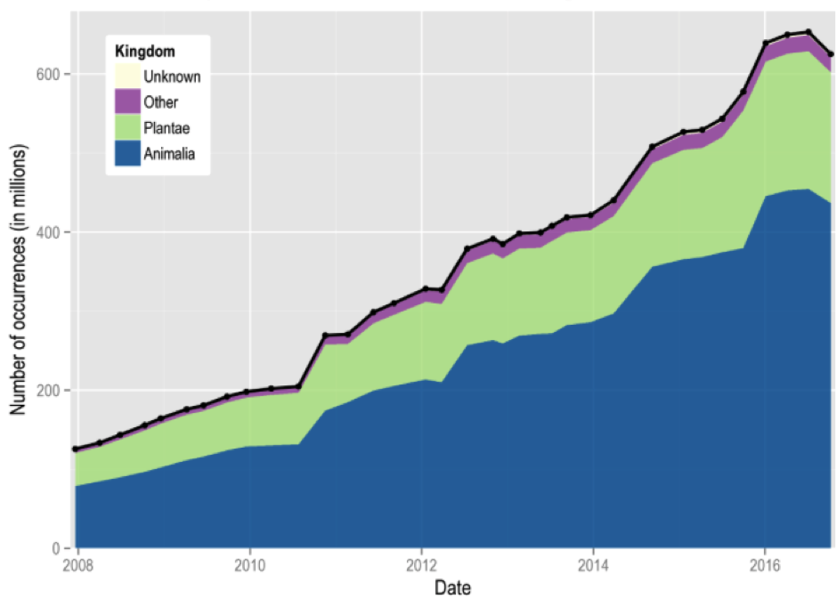
Data publishing trend

Slide 7


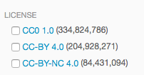
Standard licence implementation
Analysis of existing licences for datasets in the network, based on the decision at GB21
GBIF Integrated Publishing Toolkit (IPT) v.2.2 supports selection of one of three machine-readable options (CC0, CC BY, CC BY-NC)
Targeted communication with publishers to confirm licence assignment (Nov 2015-Mar 2016)
– thanks to 24 country Nodes for running the communication within their own publisher communitie
Notes:
Nodes who lead their own consultation (only country nodes were approached):
Argentina, Australia, Belgium (and DRC), Brazil, Canada, Colombia, Denmark, France, Germany, Iceland, Ireland, Israel, Japan, Luxembourg, Netherlands, Norway, Poland, Portugal, South Africa, Spain, Sweden, Switzerland, US (and VertNet)

Slide 8
Standard licence implementation
CC0 and CC BY cover close to 90% of datasets, accounting for 87% of records (>53% of records with CC0)
CC BY-NC covers about 12% of datasets / almost 13% of records
Temporary data loss:
~4% of records, about 600 datasets
Licences assigned to all occurrence datasets!
Next step: checklists
Status: Oct 2016
Notes:
24 country nodes agreed to handle the consultation with their publishers themselves. All other publishers, including all endorsed by non-country participants, were contacted directly by GBIFS
Timeline:
Nov 2015: provided country nodes with relevant materials (overview of relevant publishers, datasets and licenses, drafts proposed for communication). Other publishers contacted directly
Response deadline (Jan 31, 2016) was extended to end of Feb 2016. In March 2016, some responses are still outstanding, but the majority of datasets (about 98%, accounting for >95% of occurrence records) can be assigned one of the three available licenses
Some more responses still expected, as we are aware that some nodes are still in communication with their publishers. However, this should not hold the implementation

Slide 9
Data download requests, by country
1 | United States | 10,296
2 | Mexico | 9,066
3 | Brazil | 5,129
4 | United Kingdom | 3,709
5 | Colombia | 3,278
6 | Spain | 3,131
7 | China | 2,337
8 | India | 2,182
9 | Italy | 1,602
10 | South Africa | 1,316

Slide 10

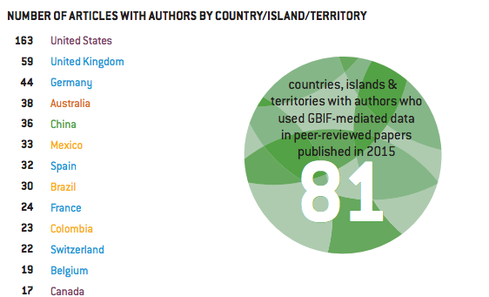

Gbif science review 2016
http://www.gbif.org/resource/82873 ,http://www.gbif.org/resource/8287 2

Slide 11
literature tracking
Publications using GBIF-mediated data

Slide 12
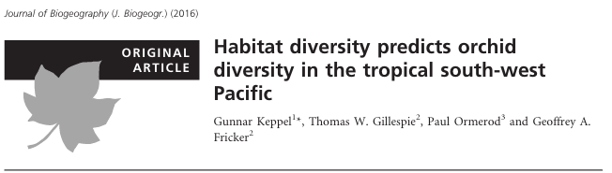
Citation practices … getting better!
    Paper analyses all described orchid species on eight archipelagos east of New Ireland
    Which biogeographical variables predict orchid diversity and endemism?
    Can climatic and/or topographic variables reliably predict diversity?
http://doi.wiley.com/10.1111/jbi.12805

Slide 13
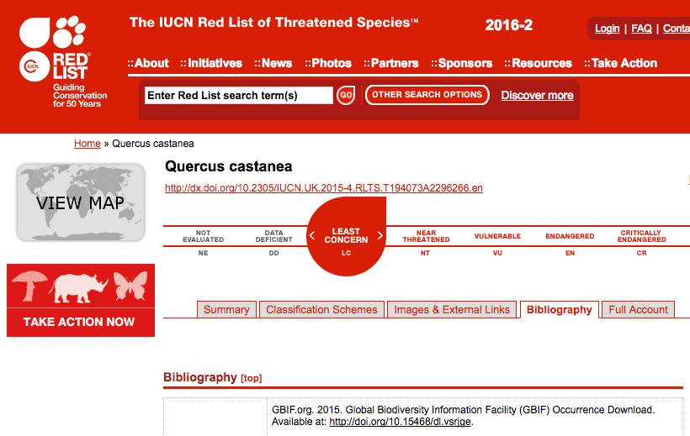
Citation practices … getting better!

Slide 14
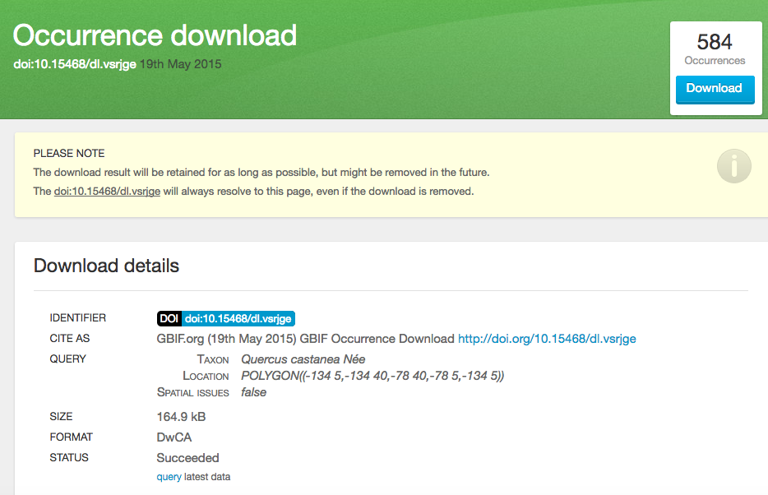
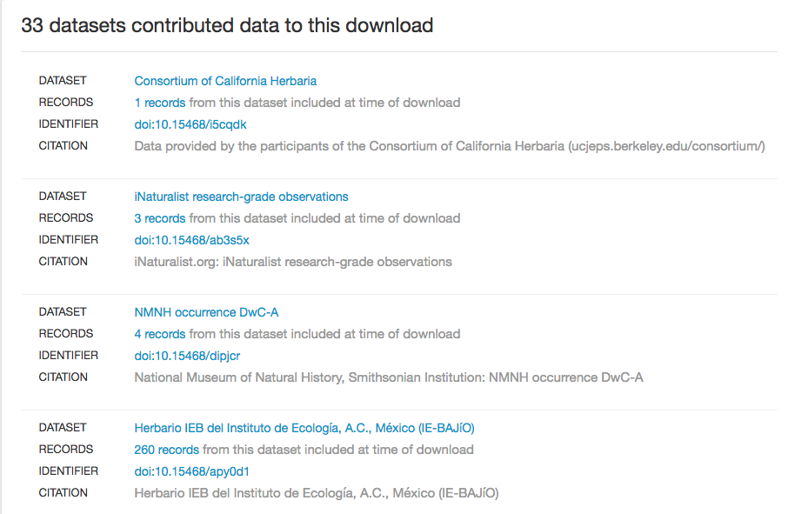
Citation practices … getting better!

