Slide 1
Togo: a BID national project in Africa
Prof. Pierre RADJI
Node Manager
GBIF TOGO
Brazilia GBIF, GB23

Slide 2


GBIF Togo – Building our Node
SEP projects: Modernize National Herbarium and computarize sheets data
Mentoring with GBIF France: Data publication starts
Join GBIF as Associate Participant
Become Voting Participant
Mentoring with Belgian BIF to train Node staff on GBIF tools and standards: IPT, DwCA
2016-2018:
BID Project to strengthen national data holders network
2008
2009
2011
2013
2015
Notes:
Togo started working on biodiversity informatics since 2008. The country got SEP projects to modernize the national herbarium and to computarize sheets data.
Then on 2009, Togo joined GBIF community becoming an Associate participant and worked respectively with GBIF France, BelgianBIF and GBIF Mauritanian through GBIF Mentoring projects. These mentoring projects help Togo’s node to start data publication, to train node staff on GBIF tools and standards like IPT and DwCA and started building a national data holders network.
The staff has worked and continue working with its line ministry that is the Ministry of Higher education and research and in 2015 Togo become Voting participant.
From june 2016 to 2018, the node got a national grant on BID project funded by EU, to strengthen national data holders network.

Slide 3
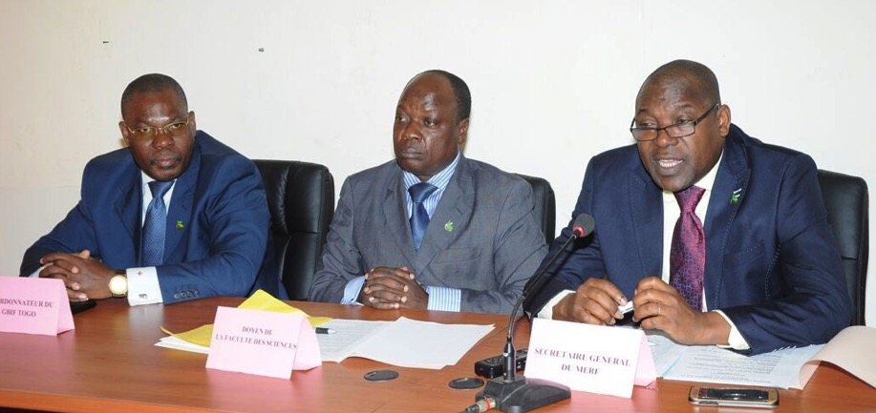

BID national Project
Participants:
Local partners: 31 national institutions (data holders)
GBIF Community: Belgian Biodiversity Platform, Canadensys
Aims:
Strengthen GBIF Togo by collecting, digitizing, cleaning, geo-referencing and publishing more than 100 000 records
Strengthen data holders national network helping to bring together national stakeholders in data publishing
This programme is funded by the European Union
Notes:
On the mentoring projects, the data holders network was built but unfortunately doesn’t work and data records published up to now are very low so the aim of this BID project is to Strengthen this network helping to bring together national data holders in data publishing and to strengthen GBIF Togo presence on the global network by collecting, digitizing, cleaning, geo-referencing and publishing more and more data records.

Slide 4
Deliverables | Activity description
Deliverables for GOAL 1 - Establish or strengthen national biodiversity information facilities
Capacity enhancement (stakeholders, Node Team) Sensitization workshop: Awareness of politicians and decision makers | * Operation and web presence administration * Achievement of national inventory of biodiversity data, * Strengthen IPT metadata publishing * Data georeferencing and data papers publication
 | * GBIF structure and tools * Gain and benefits to publish data on www.gbif.org * Setting up of national community of biodiversity data holders and users
 | * Importance of biodiversity data mobilization * Why and how to support mobilization effort? * Why and how to use Biodiversity data for development (science, health, management, etc.
Deliverables for GOAL 2 - Increase available biodiversity data, within and beyond the grant period
By publishing biodiversity data By editing and publishing Data Papers coming from scientists and policy makers (Ministry of Environment) | * Implementation of National metadata catalogues * Digitization and publishing of Natural history collections (Botanical, Zoological, Entomological, etc.) * Validation and publishing of oobservation data in Togo protected area: Oti-Keran, Abdoulaye ranked forest, Togodo Fauna reserve, National Park, Fazao-Malfakassa National Park, etc. * Data papers preparation by scientists
Deliverables for GOAL 3 - Apply biodiversity data in response to national priorities
National survey to Understand the biodiversity data requirements Data use understanding survey | * National surveys followed by validation workshop to understand the biodiversity data requirements for education, research and health uses. * Data mobilized on protected area, urban ecology, minor plants, invasive plants are published on www.gbif.org
Capacity enhancement in data analysis and data use is done (Data use promotion) | * Workshop on data analysis techniques * Workshop and advocacy actions to promote data use (with policy makers, resources users and other biodiversity stakeholders)
Notes:
To achieve these aims, data holders, node staff, scientists, politicians and decision makers need to be sensitizing on the importance of data mobilization, on capacity enhancement in data analysis and use for development (especially in health, education, environment, etc).

Slide 5
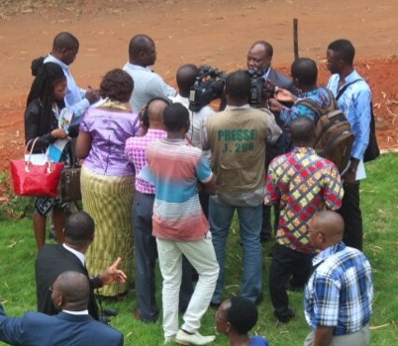
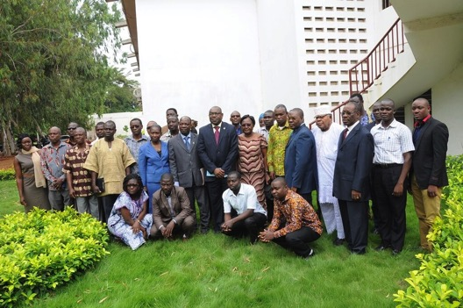
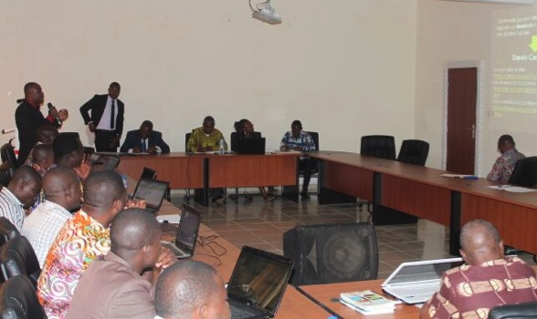
PROJECT PROGRESS
June to September: 3 Meeting with local partners
June to October: Skype meeting, Email, GoogleDocs with external partners
September 2016: Launching meeting/workshop with data holders (31 dh + 14 local media)
October: First report in progress
Coming soon
  21-25 November 2016: First National Workshop
This programme is funded by the European Union
Notes:
The launch meeting was done in the presence of 14 local media called to relay information on the entire national territory.
- 21 -25 November 2016: First National Workshop that will be focusing on data analysis and data uses.
On next February, another workshop will talk about How to use data to publish Data paper. The workshop will be very practice with at the end much publishable paper as scientist participant.

Slide 6
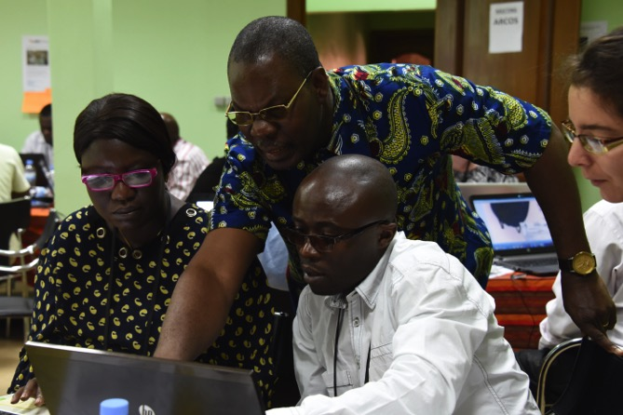

Togo’s contribution to the BID Community of Practice
Involved in mentoring at Kigali workshop and in BID community,
Supporting outreach efforts,
Supporting GBIF community document translations (English – French)
Notes:
Otherwise,
GBIF Togo node is contributing to the BID community of practice by supporting outreach efforts and gbif community document translations.
GBIF Togo is always open for collaboration and partnership.

Slide 7
Togo: a BID national project in Africa
Prof. Pierre RADJI
Node Manager
GBIF TOGO
Brazilia GBIF, GB23
Notes:
Thanks for your attention.

